Slide 1
Game Design and Programming
Neil Gannon

Slide 2
Today
Revision of core topics from last semester
Language features of C#
Variables
Methods
Objects and Instances
Statements and Data Types
Game State
Visualising State in Game

Slide 3
Revision

Slide 4
Scripts
Scripts are short segments of code that perform a specific task
We can write our own custom scripts
Preferably scripts would be reusable across different objects
Scripts can be used across a wide range of areas
Initial variable declaration and instantiation
Game logic and state management
Game I/O
Already used a lot of scripts and predefined methods
Movement, Collision Reactions, Game Logic, etc.

Slide 5
Events (Methods)
Each object features a series of predefined events that can be raised
Start, Update, OnCollisionEnter2D, OnTriggerEnter2D
Events are responsible for executing our code
We typically make programming design decisions around these events
If Object X collides with Object Y then do something… (Collision Event)
If Object Q is thirsty then go and find water (Update Method)

Slide 6
Instance Creation
We create definitions of objects in GameMaker
When this object is added to a room we are creating a new instance
This instance is it’s own unique clone of the original object
We can modify each individual instance properties
When we create a new instance of an object we can attach a script to be executed
Allows us to modify specific instances
Have game objects that have different properties outside of the original definition

Slide 7
Objects
An object is a preconfigured resource from which instances will be created
Typically objects have important properties
Sprite
Position
Direction
Health, Score
When we place an object in a room
We are creating an instance (clone) of the object
Adding that specific instance to the room

Slide 8
Instances
Instances are created from objects
They contain all the preconfigured elements of the original object
Each instance of an object contains it’s own set of variable values
Same named variables but with different assignments
These can be accessed or modified by other instances
Objects will a unique name to differentiate them from others
Later it will be important to be able to find a specific instance of an object
Preform some task on that one/group of objects

Slide 9
Variables
Like other programming languages C# uses variables
Basic unit for most operations
Can store different data types in memory
Named for easy retrieval/modification
Variable Stages
Declaration
Assignment
Usage
Variables have scope
The area of where this variable is to be used

Slide 10
Variable Scope
Instance
These variables are defined within an instance
Unique to that instance and can be used by any script/event of that object
Can be accessed from other objects
Local
Local variables only exist for the lifetime of the script they are in
Once the script is finished executing the variable is forgotten
Global
Part of the game itself and not tied to any one instance
Can be accessed from any other piece of code
Shared data
Built-In
Pre-defined variables that are present in all objects (X,Y, Direction, etc.)
Cannot be removed
Reserved Names

Slide 11
Methods/Functions
A method contains series of code statements
Typically takes some inputs, performs operations, returns an output
Typically very specific in nature
Requires a unique name
In Unity we can custom methods
We can define inputs and output
Can be called from any other piece of code
Useful for removing duplicated code and creating reusable code

Slide 12
Statements and Data Types
C# features a range of built in statements
IF, ELSE, WHILE, SWITCH, FOR
These are language level features that allow us to perform various operations and conditional logic
In C# we have declare the data type when creating a variable
You simply need to give the variable a name and assign the data to it
String
Booleans
Int
Float
Arrays, Enum (to be covered this semester)

Slide 13
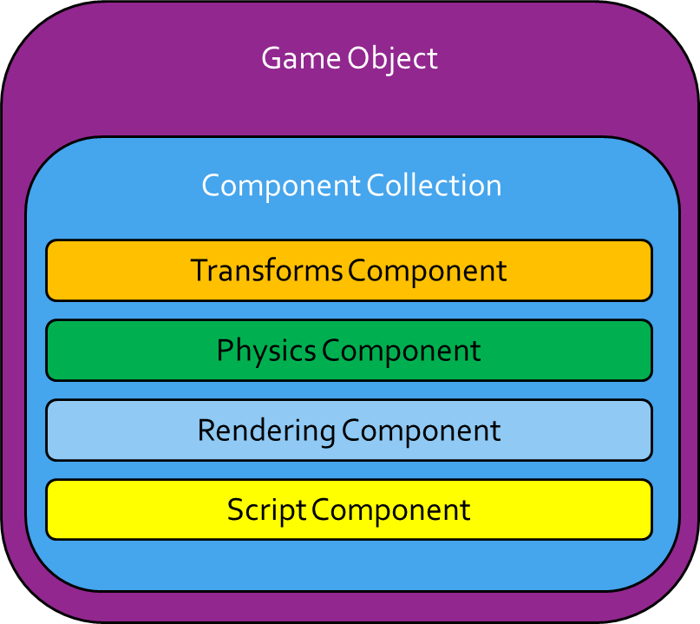
Game Objects and Components
In Unity any object that is placed in a scene is known as a game object
Game Objects have no game related code
Instead they are designed to have components attached to them
Components are single self-contained units that perform a single specialised task.
Commonly known as scripts
We write a script and then attach it to a Game Object
This way we can reuse all of our components among all of our game objects.

Slide 14
Key Script Properties
gameObject
transform
x
y
Up
tag
name

Slide 15
Key Script Methods
Destroy
Instantiate
SetActive
GetComponent
GetComponentInParent
GetComponentInChildren

Slide 16
Game State
All the object instances and variables that exist while a game is running can be referred to as the game state
The state gives us a snapshot of objects and their variable values at a given point in time
The state is central to game logic
Operations will performed on the state
Gameplay logic will depend on the values stored in the state
Saving of state for checkpoints/save games
We sometimes want to be able to view certain parts of the state
Debug state view

Slide 17
Reusable Scripts

Slide 18
Health Component
Both the player and enemies will have “Health”
Properties
Health
isDead
enemyTag
doDestroyOtherObjectOnCollision
Methods
We want to be able to Add an amount to the existing health
We want to be able to Subtract an amount from the existing health

